Slide 1

BUSINESS INTELLIGENCE PORTFOLIO PROJECT
European Fashion Store
Sales & Business Analytics Dashboard
Power BI | Data Analytics & Business Intelligence
[Your Name]
Data Analyst | Business Intelligence Project | Power BI

Slide 2






INTRODUCTION
Project Overview
This project analyzes European fashion-store performance across sales, customers, products, campaigns, inventory, countries and channels — turning raw transactional data into an interactive Power BI decision-making tool.
Sales
Customers
Products
Campaigns
Inventory
Countries & Channels
FROM RAW DATA TO BUSINESS INSIGHT
Raw Data
Data Cleaning
Data Modeling
DAX
Dashboard
Business Insights
EUROPEAN FASHION STORE | SALES & BUSINESS ANALYTICS
02

Slide 3

THE CHALLENGE
Business Problem
Business data is spread across six disconnected tables, leaving stakeholders without a centralized view of overall performance:
Limited visibility into overall sales performance
Difficulty identifying high-performing products
Challenges in understanding customer behavior
Difficulty evaluating campaigns and discount strategy
Limited visibility into inventory & stock-outs
Difficulty comparing countries and sales channels
EUROPEAN FASHION STORE | SALES & BUSINESS ANALYTICS
03

Slide 4

GOALS
Project Objectives
Analyze sales & revenue performance
Understand customer behavior
Identify top-performing products & categories
Evaluate campaign effectiveness
Monitor stock & out-of-stock products
Compare country & channel performance
Support data-driven business decisions
EUROPEAN FASHION STORE | SALES & BUSINESS ANALYTICS
04

Slide 5

THE DATA
Dataset Overview
Customer
Campaign
Product
Demographics & acquisition
Campaign & discount information
Brand, category & pricing
Sales Item
Stock
Stores Sales
Item-level sales transactions
Inventory and availability
Sales, customers, channels & revenue
6 TABLES • RELATIONAL BUSINESS DATASET • MULTI-DIMENSIONAL ANALYSIS
EUROPEAN FASHION STORE | SALES & BUSINESS ANALYTICS
05

Slide 6
PREPARATION
Data Preparation & Transformation
Data cleaning & duplicate handling
Null / missing value treatment
Data-type validation
Standardization of categorical fields
Date preparation & formatting
Relationship creation across tables
Calculated columns
DAX measures for KPIs
TRANSFORMATION PIPELINE
Raw Data
Power Query
Data Model
DAX
Visualization
EUROPEAN FASHION STORE | SALES & BUSINESS ANALYTICS
06

Slide 7
POWER BI IN ACTION
The Dashboards
A guided walk-through of the report's navigation home, data model and five analytical dashboards, in the same order used inside Power BI.
EUROPEAN FASHION STORE | SALES & BUSINESS ANALYTICS
07

Slide 8
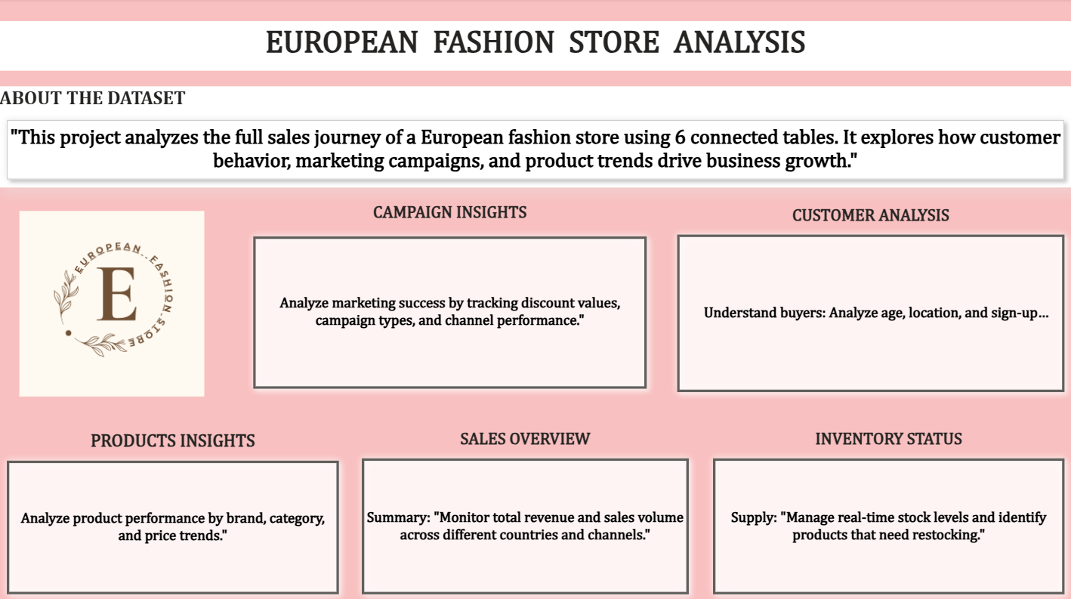
DASHBOARD 1
Report Home & Navigation
WHAT IT SHOWS
Central landing page summarizing all 6 connected data tables
One-click navigation into Campaign, Customer, Product, Sales and Inventory pages
Short descriptions frame the business purpose of each report page
Designed for fast orientation across the full analytics suite
BUSINESS QUESTION
How can stakeholders navigate the full analytics suite quickly?
EUROPEAN FASHION STORE | SALES & BUSINESS ANALYTICS
08

Slide 9
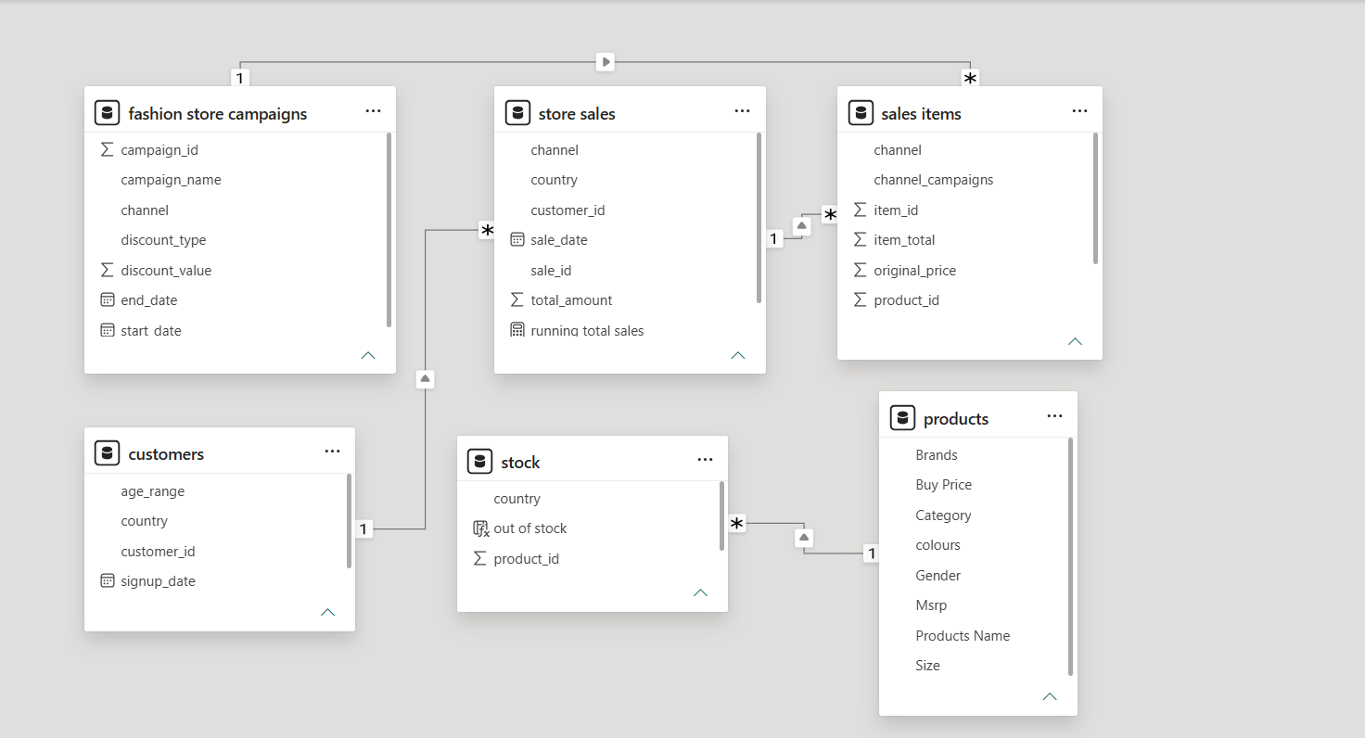
DASHBOARD 2
Data Model & Relationships
WHAT IT SHOWS
Star-schema style relationships across all 6 tables
Customers, Products & Campaigns act as dimension context
Store Sales, Sales Items & Stock carry transactional facts
One-to-many relationships enable correct filter propagation
Optimized structure supports fast, accurate DAX measures
BUSINESS QUESTION
How is the underlying data structured to support reliable analysis?
EUROPEAN FASHION STORE | SALES & BUSINESS ANALYTICS
09

Slide 10
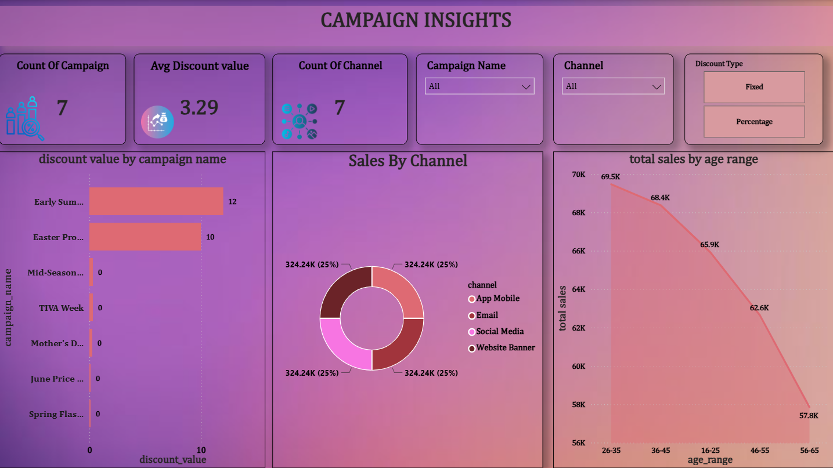
DASHBOARD 3
Campaign Analytics
WHAT IT SHOWS
7 campaigns tracked with an average discount value of 3.29
Discount value by campaign — Early Summer and Easter Promotions lead activity
Sales evenly distributed across App Mobile, Email, Social Media & Website Banner
Total sales by age range declines steadily from 69.5K (26-35) to 57.8K (56-65)
BUSINESS QUESTION
Which campaigns and promotional strategies perform effectively?
EUROPEAN FASHION STORE | SALES & BUSINESS ANALYTICS
10

Slide 11
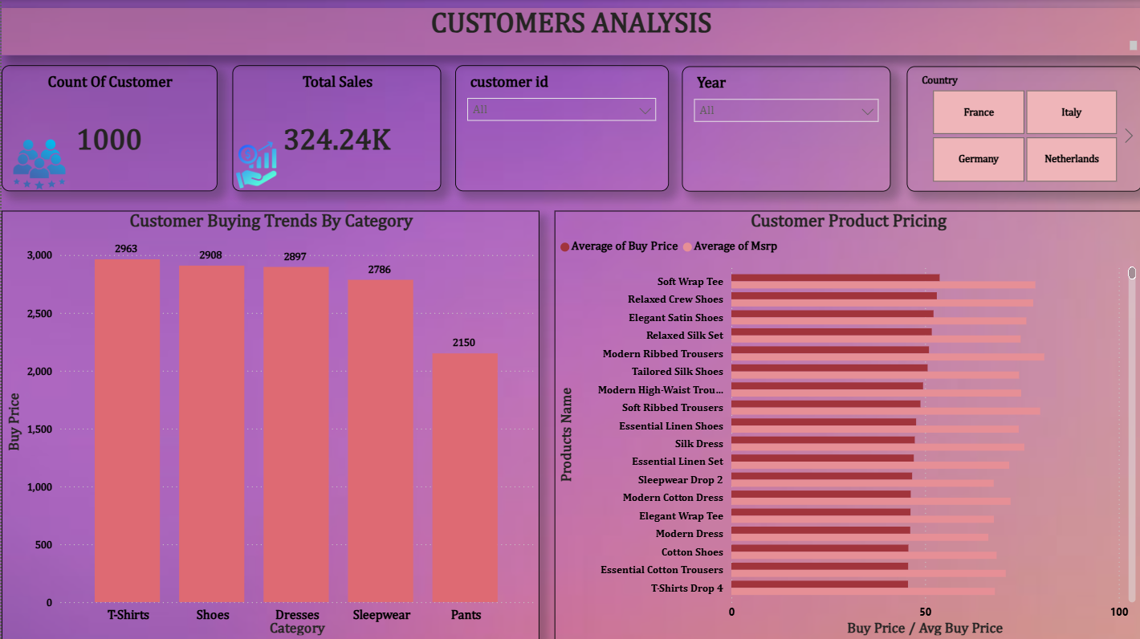
DASHBOARD 4
Customer Analytics
WHAT IT SHOWS
Customer count and total sales KPIs with Country / Year filters
Buying trends by category, led by T-Shirts, Shoes and Dresses
Average buy price vs MSRP compared across top products
Country slicers for France, Italy, Germany and the Netherlands
BUSINESS QUESTION
Who are our customers, and how do they contribute to the business?
EUROPEAN FASHION STORE | SALES & BUSINESS ANALYTICS
11

Slide 12
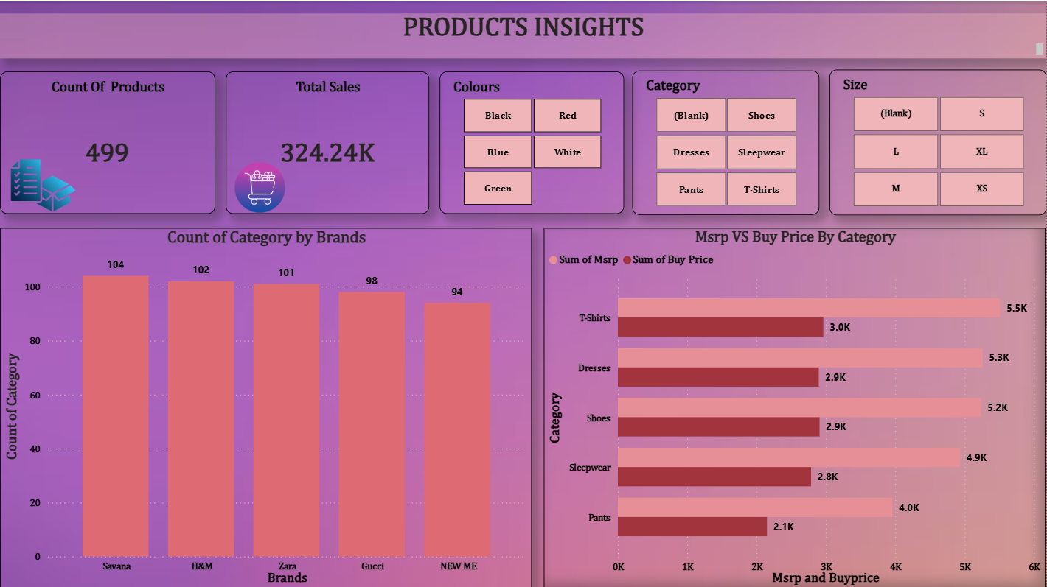
DASHBOARD 5
Product Performance
WHAT IT SHOWS
Total product count (499) and total sales KPI
Category count by brand — Savana, H&M, Zara, Gucci and NEW ME
MSRP vs Buy Price compared by category to assess margin
Filters for colour, category and size for deeper drill-down
BUSINESS QUESTION
Which products, brands and categories are driving performance?
EUROPEAN FASHION STORE | SALES & BUSINESS ANALYTICS
12

Slide 13
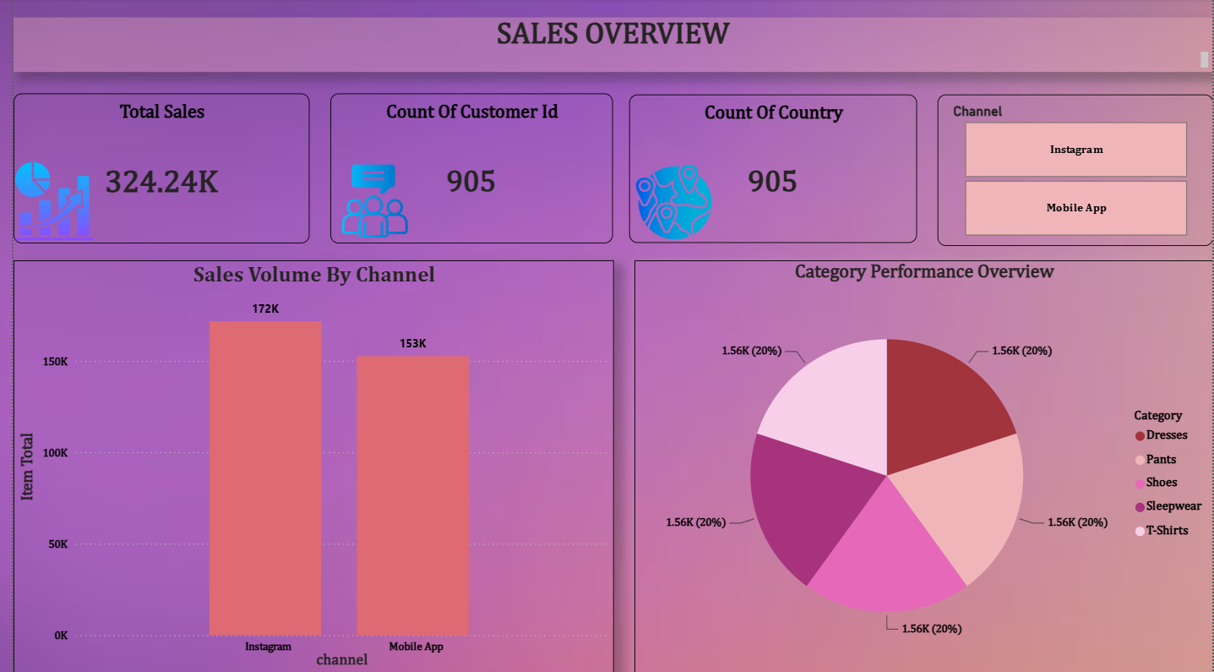
DASHBOARD 6
Executive Sales Overview
WHAT IT SHOWS
Total Sales, customer count and country count at a glance
Sales volume compared across Instagram vs Mobile App channels
Category performance overview showing revenue share by product category
Interactive channel slicer for on-the-fly filtering
BUSINESS QUESTION
How is the fashion store performing overall?
EUROPEAN FASHION STORE | SALES & BUSINESS ANALYTICS
13

Slide 14
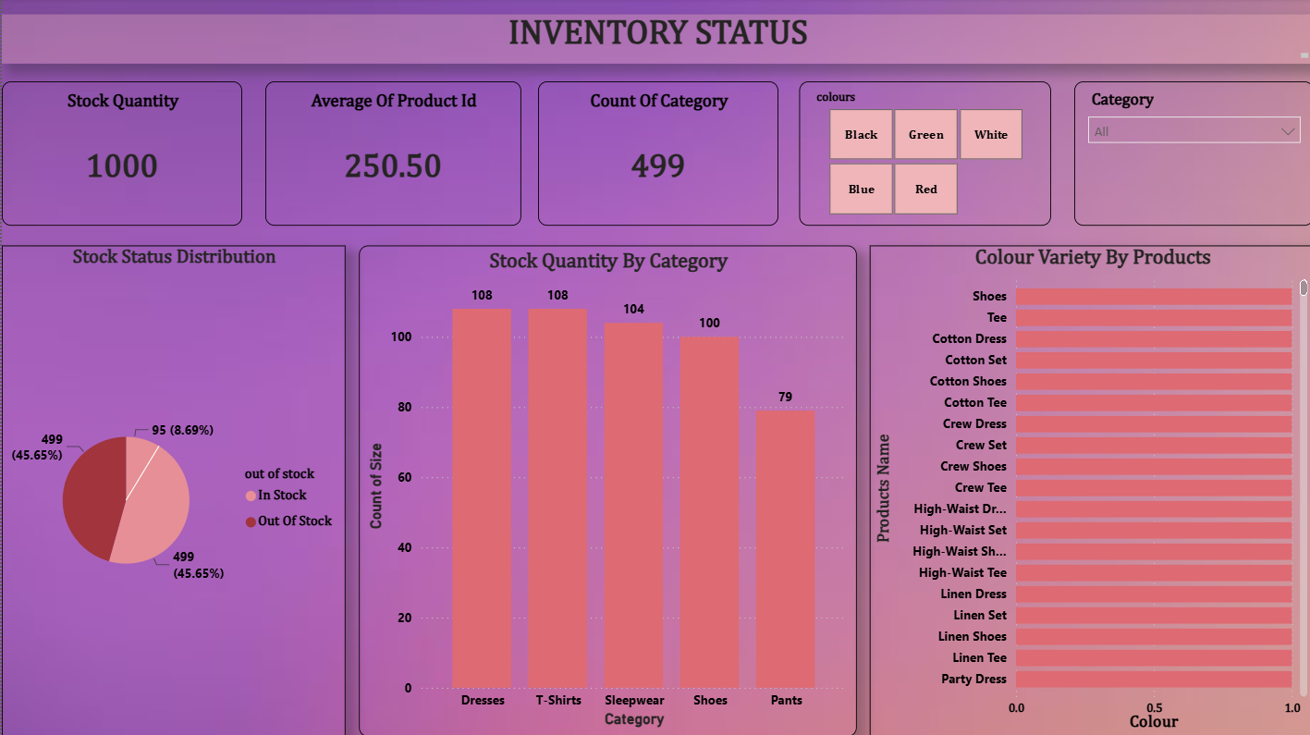
DASHBOARD 7
Inventory & Stock Analytics
WHAT IT SHOWS
1,000 total stock units tracked across 499 categories
Stock status split: 45.65% in stock vs 45.65% out of stock
Stock quantity by category — Dresses and T-Shirts hold the most units
Colour-variety breakdown available by individual product
BUSINESS QUESTION
Where are the inventory gaps that could affect sales?
EUROPEAN FASHION STORE | SALES & BUSINESS ANALYTICS
14

Slide 15
FINDINGS
Key Business Insights
Sales
Customer
Product
Instagram outpaces Mobile App (172K vs 153K), and the five product categories share revenue almost evenly (~20% each).
1,000 customers span France, Italy, Germany and the Netherlands, with T-Shirts, Shoes and Dresses as the top buying categories.
499 products across 5 brands (Savana, H&M, Zara, Gucci, NEW ME) show consistent MSRP-to-buy-price margins by category.
Why it matters: Guides where to focus channel investment.
Why it matters: Shows which segments to target for retention.
Why it matters: Highlights which categories protect margin best.
Campaign
Inventory
Geography / Channel
Early Summer and Easter Promotions carry the highest discount activity among 7 tracked campaigns; sales split evenly across 4 channels.
Stock is nearly split down the middle — 45.65% in stock vs 45.65% out of stock across 1,000 units.
Sales are tracked consistently across countries and both digital channels, enabling direct market comparison.
Why it matters: Identifies which campaigns merit repeating.
Why it matters: Flags a meaningful stock-out risk to manage.
Why it matters: Supports market-level expansion decisions.
EUROPEAN FASHION STORE | SALES & BUSINESS ANALYTICS
15

Slide 16

NEXT STEPS
Business Recommendations
Reduce stock-out risk for high-demand categories like Dresses & T-Shirts
Reinvest in Instagram given its stronger channel contribution
Repeat and scale Early Summer & Easter-style promotional campaigns
Protect margin by monitoring MSRP-to-buy-price gaps by category
Use age-range and country segmentation for targeted promotions
Track brand-level performance to prioritize top-performing partners
Balance channel mix across Email, Social Media & Website Banner
Adopt the Power BI dashboard for ongoing performance monitoring
EUROPEAN FASHION STORE | SALES & BUSINESS ANALYTICS
16

Slide 17
CAPABILITIES
Tools & Technical Skills
TECHNICAL SKILLS
TOOLS
Data Cleaning
Data Transformation
Data Modeling
Power BI
Star Schema
DAX Measures
KPI Development
Power Query
DAX
Data Visualization
Dashboard Development
Business Intelligence
Excel / CSV
Sales Analytics
Customer Analytics
Inventory Analytics
Campaign Analysis
EUROPEAN FASHION STORE | SALES & BUSINESS ANALYTICS
17

Slide 18
CONCLUSION
This project transformed six connected fashion-retail tables into a single, interactive Power BI business-intelligence solution.
Monitor sales performance
Understand customers
Evaluate products
Measure campaign effectiveness
Monitor inventory
Compare countries & channels
“Turning Retail Data into Actionable Business Insights.”
EUROPEAN FASHION STORE | SALES & BUSINESS ANALYTICS
18

